Slide 1

Computer Vision Lecture 13: Local Feature Detectors Part II
School of Software, SJTU

Slide 2
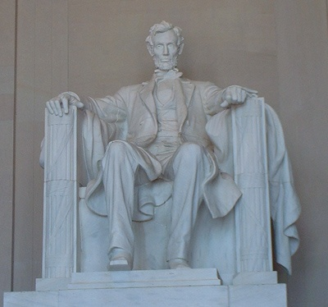
Local Features
Test image
Detector: where are the local features?
Descriptor: how to describe them?

Slide 3
Outline
Invariance
Multi-scale Oriented Patches
Scale Invariant Feature Transform (SIFT)
Examples and Applications of SIFT

Slide 4
Local Features: Invariance
Suppose you rotate the image by some angle.
Will you still pick up the same features?
What if you change the brightness?
What about scale?
We’d like to find the same features regardless of the transformation.
This is called transformational invariance.
Most feature methods are designed to be invariant to
Translation, 2D rotation, scale
They can usually also handle
Limited 3D rotations.
Limited affine transformations (some are fully affine invariant).

Slide 5
Harris Detector: Some Properties
Rotation invariance
Ellipse rotates but its shape (i.e. eigenvalues) remains the same
Corner response R is invariant to image rotation

Slide 6
Harris Detector: Some Properties
Partial invariance to affine intensity change
Only derivatives are used => invariance to intensity shift I → I + b
Intensity scale: I → a I
R
R
threshold
x (image coordinate)
x (image coordinate)

Slide 7
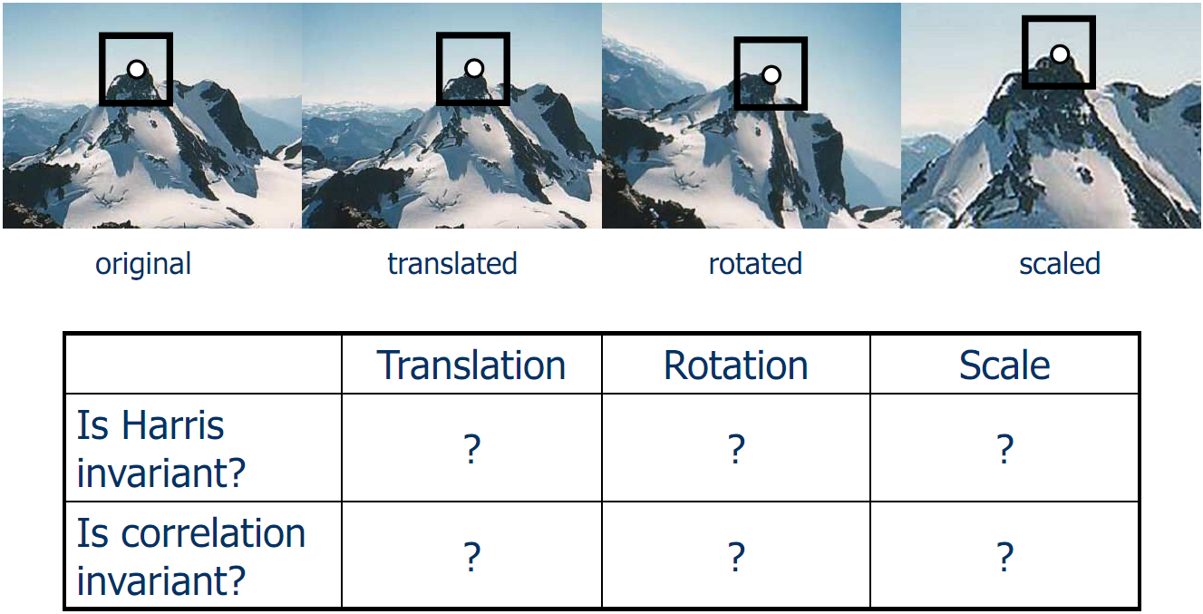
Local Features: Invariance

Slide 8
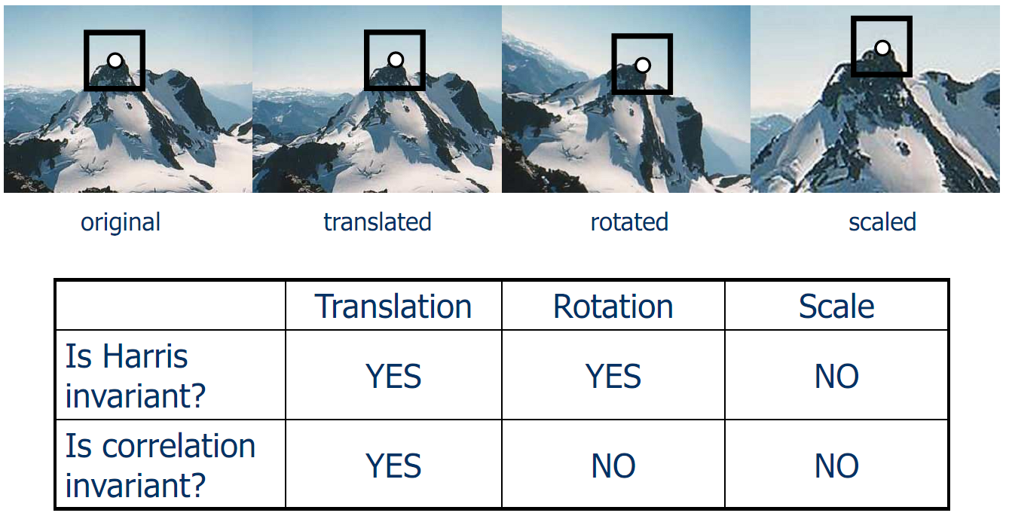
Local Features: Invariance

Slide 9
Harris Detector: Some Properties
But: non-invariant to image scale!
All points will be classified as edges
Corner !

Slide 10
Scale Invariant Detection
Consider regions (e.g. circles) of different sizes around a point
Regions of corresponding sizes will look the same in both images

Slide 11
Scale Invariant Detection
The problem: how do we choose corresponding circles independently in each image?
Choose the scale of the “best” corner

Slide 12
How to Achieve Invariance?
Need both of the following:
Make sure your detector is invariant.
Harris is invariant to translation and rotation.
Scale is trickier.
Common approach is to detect features at many scales using a Gaussian pyramid (e.g., MOPS).
More sophisticated methods find “the best scale” to represent each feature (e.g., SIFT).
Design an invariant feature descriptor.
A descriptor captures the information in a region around the detected feature point.
The simplest descriptor: a square window of pixels.
What’s this invariant to?
Let’s look at some better approaches…

Slide 13
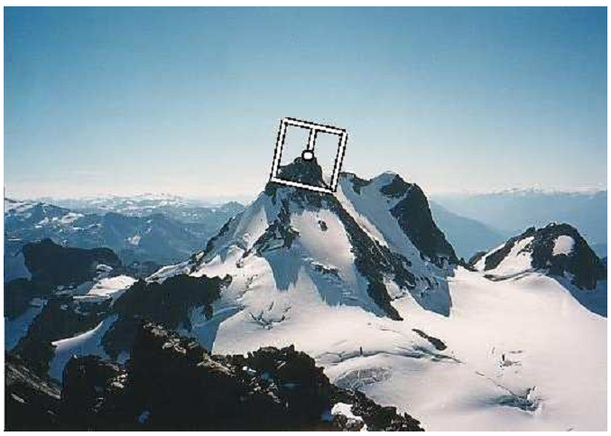
Rotation Invariance for Descriptors
Find dominant orientation of the image patch.
This is given by x₊, the eigenvector of H corresponding to λ₊ (larger eigenvalue).
Rotate the patch according to this angle.

Slide 14
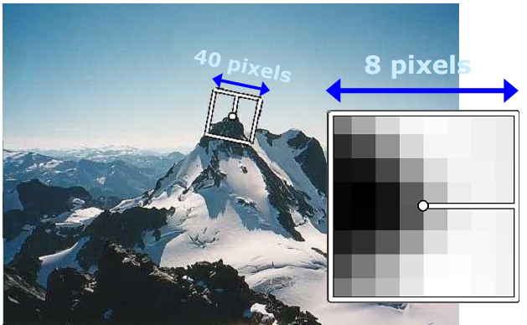
Multi-scale Oriented Patches (MOPS)
Take 40x40 square window around detected feature.
Scale to 1/5 size (using prefiltering)
Rotate to horizontal.
Sample 8x8 square window centered at feature.
Intensity normalize the window by subtracting the mean, dividing by the standard deviation in the window.

Slide 15
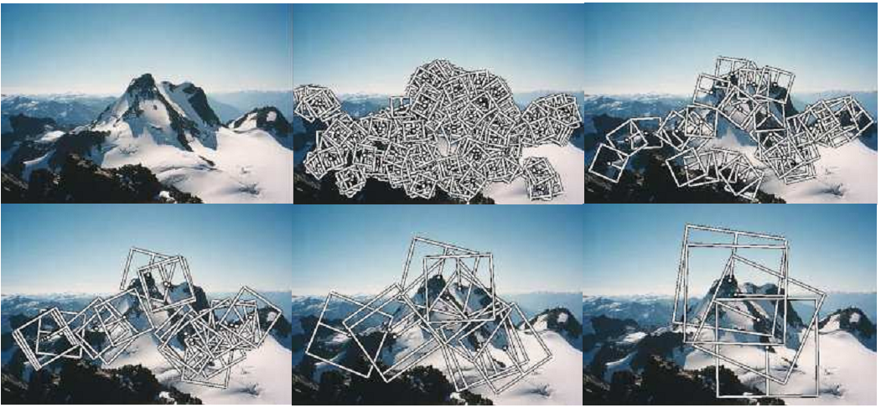
Multi-scale Oriented Patches (MOPS)
Extract orientation patches at multiple scales of the Gaussian pyramid.

Slide 16
SIFT
SIFT Background
SIFT Extraction
Application in Content Based Image Search
Conclusion

Slide 17

SIFT Background
Scale-invariant feature transform
SIFT: to detect and describe local features in images.
Proposed by David Lowe in ICCV1999.
Refined in IJCV 2004.
Cited more than 21000 times till now.
Widely used in image search, object recognition, video tracking, gesture recognition, etc.
David Lowe
Professor in UBC

Slide 18
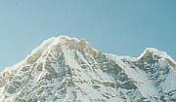
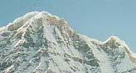
Why SIFT is so popular?
An instance of object matching

Slide 19
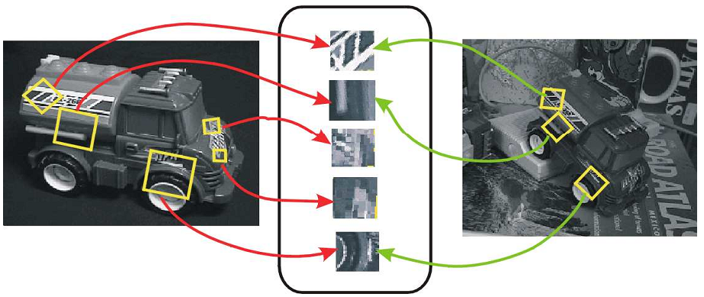
Scale Invariant Feature Transform (SIFT)
The SIFT operator developed by David Lowe is both a detector and a descriptor that are invariant to translation, rotation, scale, and other imaging parameters.

Slide 20
Why SIFT is so popular?
Desired property of SIFT
Invariant to scale change
Invariant to rotation change
Invariant to illumination change
Robust to addition of noise
Robust to substantial range of affine transformation
Robust to 3D view point
Highly distinctive for discrimination

Slide 21
Overall Approach for SIFT
Scale space extrema detection
Search over multiple scales and image locations.
Interest point localization
Fit a model to determine location and scale.
Select interest points based on a measure of stability.
Orientation assignment
Compute best orientation(s) for each interest point region.
Interest point description
Use local image gradients at selected scale and rotation to describe each interest point region.

Slide 22
Scale Space Extrema Detection
Goal: Identify locations and scales that can be repeatably assigned under different views of the same scene or object.
Method: search for stable features across multiple scales using a continuous function of scale.
Prior work has shown that under a variety of assumptions, the best function is a Gaussian function.
The scale space of an image is a function L(x,y,σ) that is produced from the convolution of a Gaussian kernel (at different scales) with the input image.

Slide 23
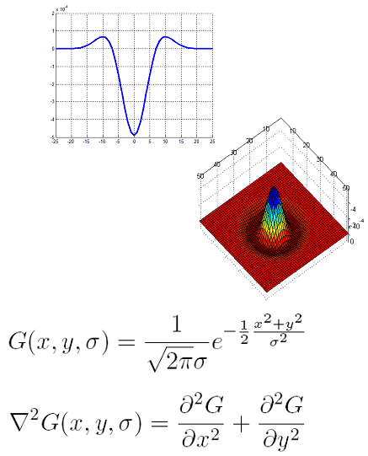
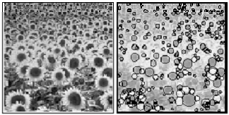
Scale Space Interest Points
Laplacian of Gaussian kernel.
Scale normalized
Proposed by Lindeberg
Scale space detection
Find local maxima across scale/space
A good “blob” detector

Slide 24
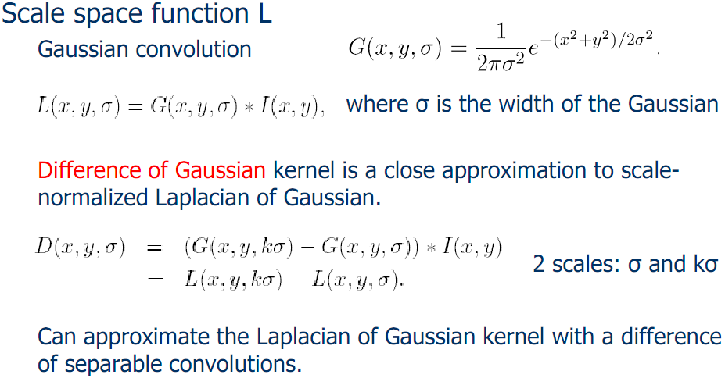
Scale Space Interest Points

Slide 25
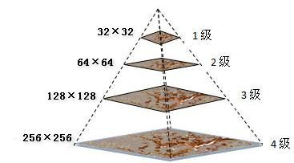
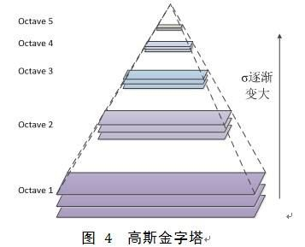
Gaussion Pyramid

Slide 26
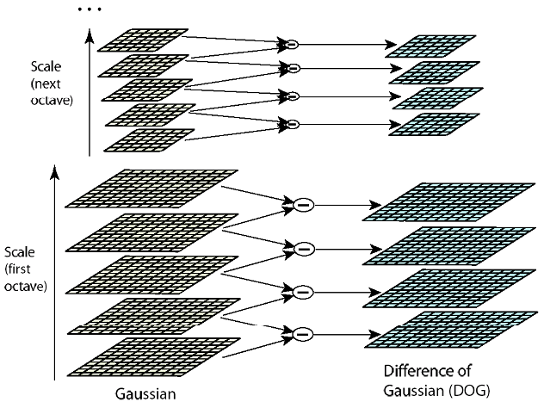
Lowe’s Pyramid Scheme
For each octave of scale space, the initial image is repeatedly convolved with Gaussian to produce the set of scale space images (left). Adjacent Gaussian images are subtracted to produce difference of Gaussian images (right). After each octave Gaussian image is downsampled by a factor of 2.

Slide 27
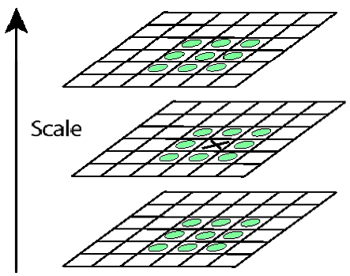
Interest Point Localization
Detect maxima and minima of difference of Gaussian in scale space.
Each point is compared to its 8 neighbors in the current image and 9 neighbors each in the scales above and below.
Select only if it is greater or smaller than all the others.
For each max or min found, output is the location and the scale.

Slide 28
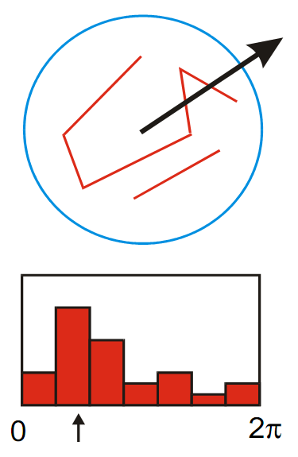
Orientation Assignment
Create histogram of local gradient directions computed at selected scale.
Assign canonical orientation at peak of smoothed histogram.
Each key specifies stable 2D coordinates (x, y, scale, orientation).

Slide 29
Interest Point Descriptors
At this point, each interest point has
location,
scale,
orientation.
Next step is to compute a descriptor for the local image region about each interest point that is
highly distinctive,
invariant as possible to variations such as changes in viewpoint and illumination.

Slide 30
Lowe’s Interest Point Descriptor
Use the normalized circular region about the interest point.
Rotate the window to standard orientation.
Scale the window size based on the scale at which the point was found.
Compute gradient magnitude and orientation at each point in the region.
Weight them by a Gaussian window overlaid on the circle.
Create an orientation histogram over the 4x4 subregions of the window.
4x4 descriptors over 16x16 sample array were used in practice. 4x4 times 8 directions gives a vector of 128 values.

Slide 31
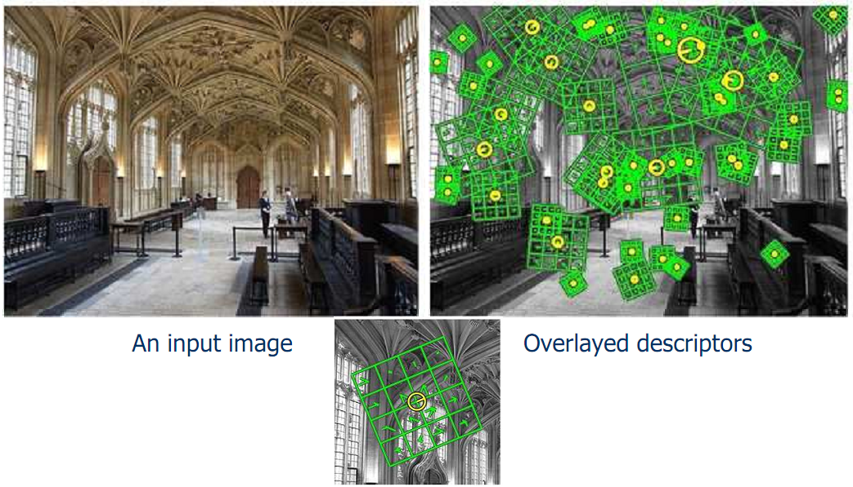
Lowe’s Interest Point Descriptor

Slide 32
Example Applications
Object and scene recognition
Stereo correspondence
3D reconstruction
Image alignment & stitching
Image indexing and search
Motion tracking
Robot navigation

Slide 33
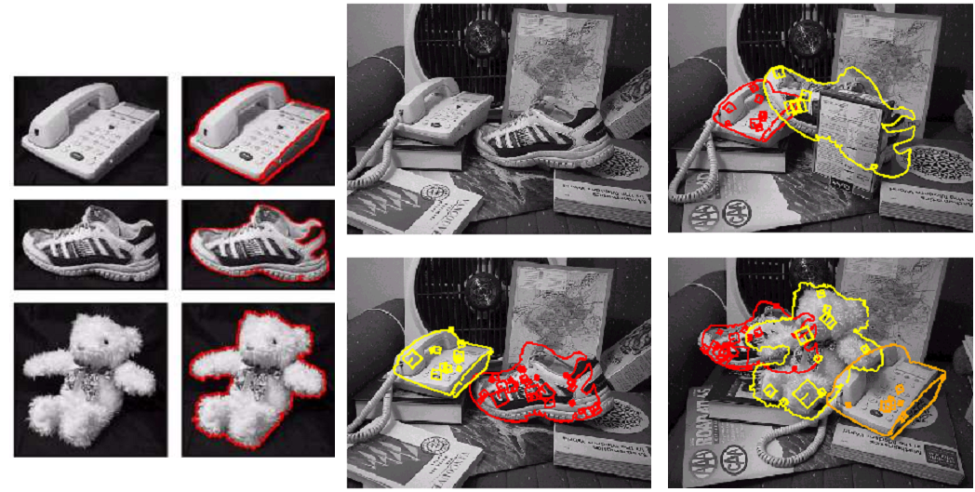
Examples: 3D Recognition

Slide 34
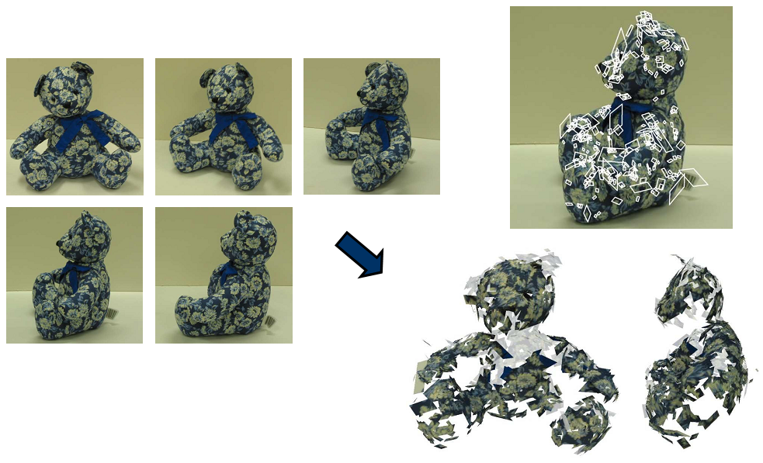
Examples: 3D Reconstruction

Slide 35
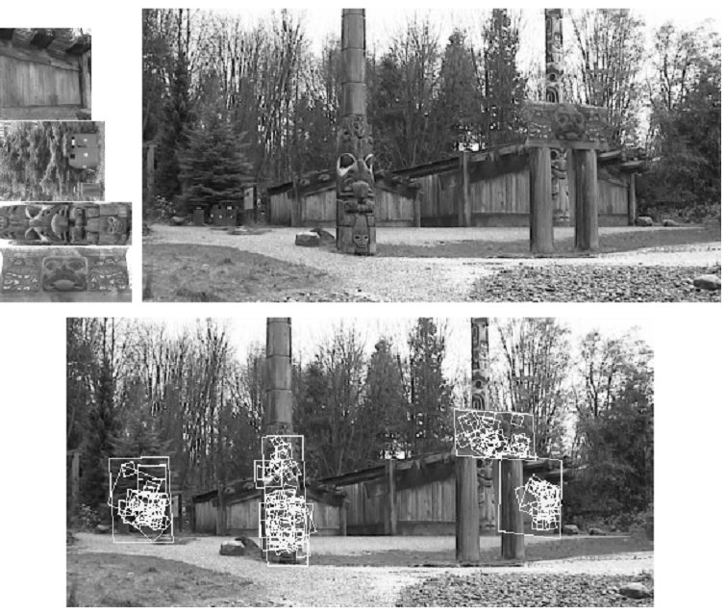
Examples: Location Recognition

Slide 36
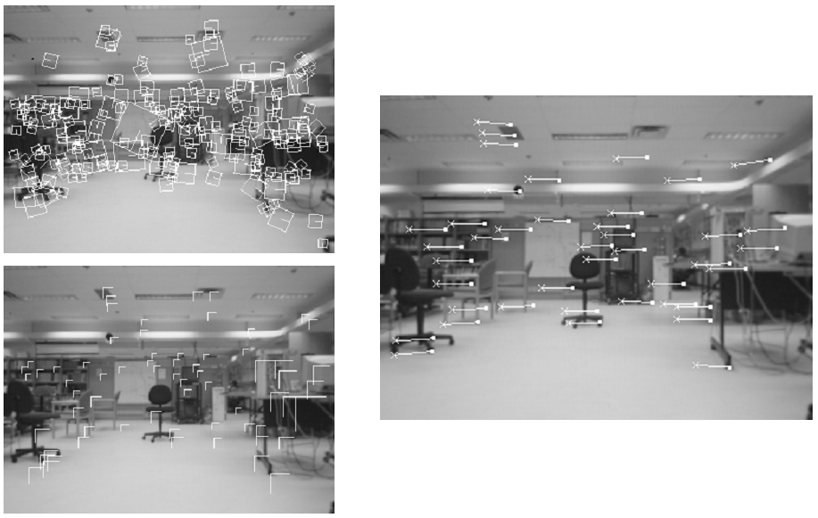
Examples: Robot Localization

Slide 37
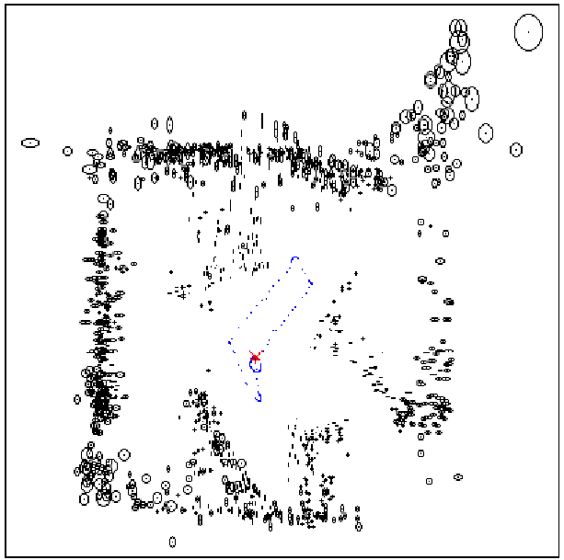
Examples: Robot Localization
Map continuously built over time

Slide 38
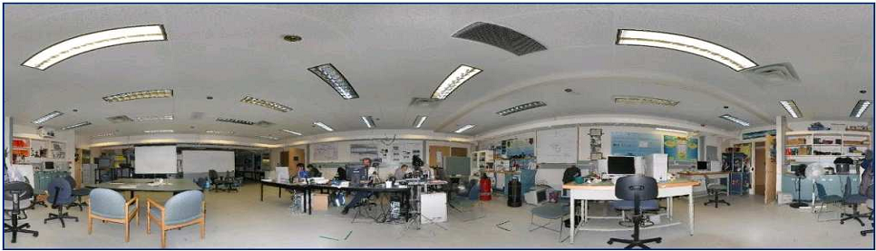
Examples: Panoramas
Recognize overlap from an unordered set of images and automatically stitch together.
SIFT features provide initial feature matching.
Image blending at multiple scales hides the seams.
Panorama of Lowe’s lab automatically assembled from 143 images

Slide 39
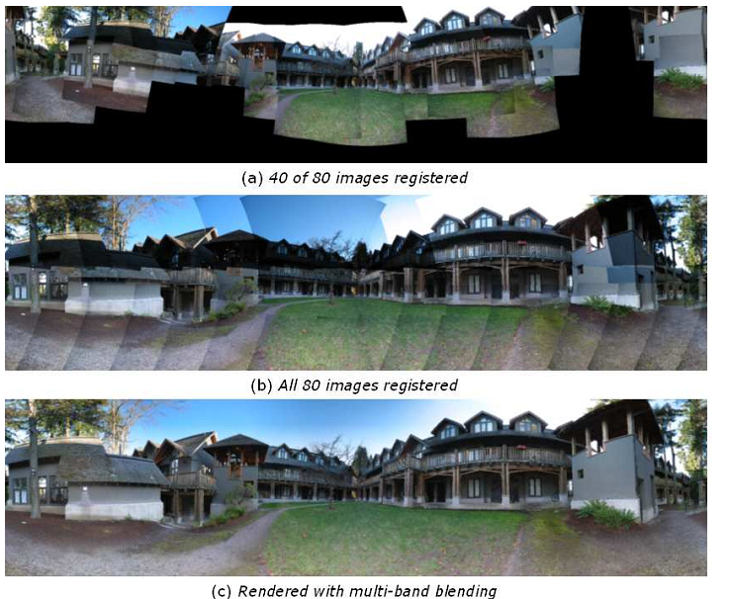
Examples: Panoramas
Image Registration and blending

